Slide 1
7 Algorithm design and problem-solving
Linear search

Slide 2



Linear search
Starting from the beginning of a data set, each item is checked in turn to see if it is the one being searched for.
A linear search:
Doesn’t require data to be in order.
Works on any type of storage device.
Is efficient for small data sets.
Is very inefficient for large data sets.
Linear search is covered in detail with fully coded examples from page 146 of our book – more information at the end of this video.

Slide 3
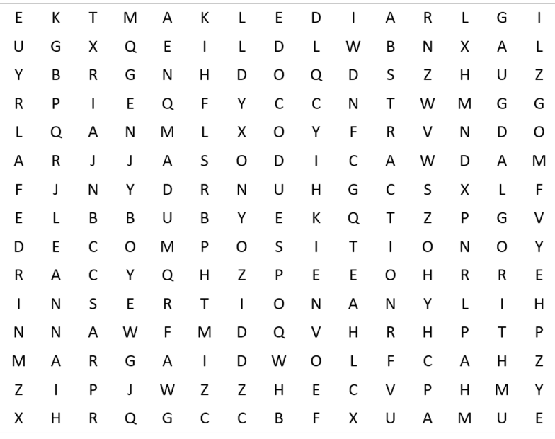
Linear search
Algorithms word search
Abstraction
Algorithm
Binary search
Bubble
Decomposition
Flow diagram
Insertion
Linear
Merge
Pseudocode

Slide 4
Linear search
Algorithms word search
Abstraction
Algorithm
Binary search
Bubble
Decomposition
Flow diagram
Insertion
Linear
Merge
Pseudocode

Slide 5

Linear search
We perform simple linear searches every day of our lives – e.g., looking for your favourite breakfast cereal on the shelves at the supermarket.

Slide 6

Linear search
FUNCTION linearSearch(items, item_to_find) RETURNS STRING
DECLARE index : INTEGER
DECLARE found : BOOLEAN
index ß 0
found ß False
WHILE (found = FALSE) AND (NOT end of data set) DO
IF items[index] = item_to_find
THEN
found ß True
ELSE
index ß index + 1
ENDIF
ENDWHILE
IF found = True
THEN
RETURN "Item found at position ", index
ELSE
RETURN "Item not found"
ENDIF
ENDFUNCTION
We have declared a function called linearSearch that takes in two parameters.
The first is an array of data items called items.
The second is the item we are going to be searching for in the array, called item_to_find.

Slide 7
Linear search
FUNCTION linearSearch(items, item_to_find) RETURNS STRING
DECLARE index : INTEGER
DECLARE found : BOOLEAN
index ß 0
found ß False
WHILE (found = FALSE) AND (NOT end of data set) DO
IF items[index] = item_to_find
THEN
found ß True
ELSE
index ß index + 1
ENDIF
ENDWHILE
IF found = True
THEN
RETURN "Item found at position ", index
ELSE
RETURN "Item not found"
ENDIF
ENDFUNCTION
We declare two additional local variables to use during the linearSearch function.
index: An integer that will be used to keep track of where we are in the items array.
found: A Boolean flag that we will set to true if we find the item we are searching for.

Slide 8
Linear search
FUNCTION linearSearch(items, item_to_find) RETURNS STRING
DECLARE index : INTEGER
DECLARE found : BOOLEAN
index ß 0
found ß False
WHILE (found = FALSE) AND (NOT end of data set) DO
IF items[index] = item_to_find
THEN
found ß True
ELSE
index ß index + 1
ENDIF
ENDWHILE
IF found = True
THEN
RETURN "Item found at position ", index
ELSE
RETURN "Item not found"
ENDIF
ENDFUNCTION
Next, we initialise starting states for local variables.
We set index to 0, as we will be starting at the beginning of the array, position zero.
We set found to false, as we are yet to find the item we will be searching for.

Slide 9
Linear search
FUNCTION linearSearch(items, item_to_find) RETURNS STRING
DECLARE index : INTEGER
DECLARE found : BOOLEAN
index ß 0
found ß False
WHILE (found = FALSE) AND (NOT end of data set) DO
IF items[index] = item_to_find
THEN
found ß True
ELSE
index ß index + 1
ENDIF
ENDWHILE
IF found = True
THEN
RETURN "Item found at position ", index
ELSE
RETURN "Item not found"
ENDIF
ENDFUNCTION
We then enter a WHILE loop until we find the item we are looking for or reach the end of the data set.

Slide 10
Linear search
FUNCTION linearSearch(items, item_to_find) RETURNS STRING
DECLARE index : INTEGER
DECLARE found : BOOLEAN
index ß 0
found ß False
WHILE (found = FALSE) AND (NOT end of data set) DO
IF items[index] = item_to_find
THEN
found ß True
ELSE
index ß index + 1
ENDIF
ENDWHILE
IF found = True
THEN
RETURN "Item found at position ", index
ELSE
RETURN "Item not found"
ENDIF
ENDFUNCTION
We check if the item we are currently looking at in the array is the one we are searching for.

Slide 11
Linear search
FUNCTION linearSearch(items, item_to_find) RETURNS STRING
DECLARE index : INTEGER
DECLARE found : BOOLEAN
index ß 0
found ß False
WHILE (found = FALSE) AND (NOT end of data set) DO
IF items[index] = item_to_find
THEN
found ß True
ELSE
index ß index + 1
ENDIF
ENDWHILE
IF found = True
THEN
RETURN "Item found at position ", index
ELSE
RETURN "Item not found"
ENDIF
ENDFUNCTION
If it is, then we set the found flag to true.

Slide 12
Linear search
FUNCTION linearSearch(items, item_to_find) RETURNS STRING
DECLARE index : INTEGER
DECLARE found : BOOLEAN
index ß 0
found ß False
WHILE (found = FALSE) AND (NOT end of data set) DO
IF items[index] = item_to_find
THEN
found ß True
ELSE
index ß index + 1
ENDIF
ENDWHILE
IF found = True
THEN
RETURN "Item found at position ", index
ELSE
RETURN "Item not found"
ENDIF
ENDFUNCTION
If it isn’t, we increment the index variable...

Slide 13
Linear search
FUNCTION linearSearch(items, item_to_find) RETURNS STRING
DECLARE index : INTEGER
DECLARE found : BOOLEAN
index ß 0
found ß False
WHILE (found = FALSE) AND (NOT end of data set) DO
IF items[index] = item_to_find
THEN
found ß True
ELSE
index ß index + 1
ENDIF
ENDWHILE
IF found = True
THEN
RETURN "Item found at position ", index
ELSE
RETURN "Item not found"
ENDIF
ENDFUNCTION
…and repeat the process.

Slide 14
Linear search
FUNCTION linearSearch(items, item_to_find) RETURNS STRING
DECLARE index : INTEGER
DECLARE found : BOOLEAN
index ß 0
found ß False
WHILE (found = FALSE) AND (NOT end of data set) DO
IF items[index] = item_to_find
THEN
found ß True
ELSE
index ß index + 1
ENDIF
ENDWHILE
IF found = True
THEN
RETURN "Item found at position ", index
ELSE
RETURN "Item not found"
ENDIF
ENDFUNCTION
Eventually, we will exit the WHILE loop.
At this point, we use an IF statement to check the value held in the found variable.
If it contains true, we return a message that the item was found along with its position in the array.

Slide 15
Linear search
FUNCTION linearSearch(items, item_to_find) RETURNS STRING
DECLARE index : INTEGER
DECLARE found : BOOLEAN
index ß 0
found ß False
WHILE (found = FALSE) AND (NOT end of data set) DO
IF items[index] = item_to_find
THEN
found ß True
ELSE
index ß index + 1
ENDIF
ENDWHILE
IF found = True
THEN
RETURN "Item found at position ", index
ELSE
RETURN "Item not found"
ENDIF
ENDFUNCTION
If it contains false, we return a message that the item could not be found.

Slide 16



Cambridge IGCSE pseudocode
The pseudocode in these videos follows the exact style that will be used in the exams.
The full set of pseudocode is defined in the syllabus:
Cambridge IGCSE (9-1) Computer Science – 0984
Cambridge IGCSE (A*-G) Computer Science – 0478

Slide 17


Essential algorithms and data structures

Slide 18
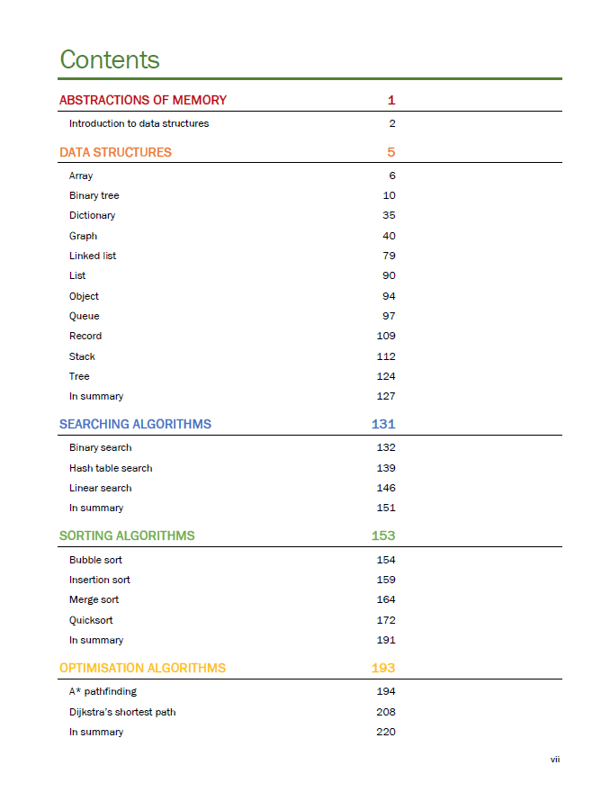
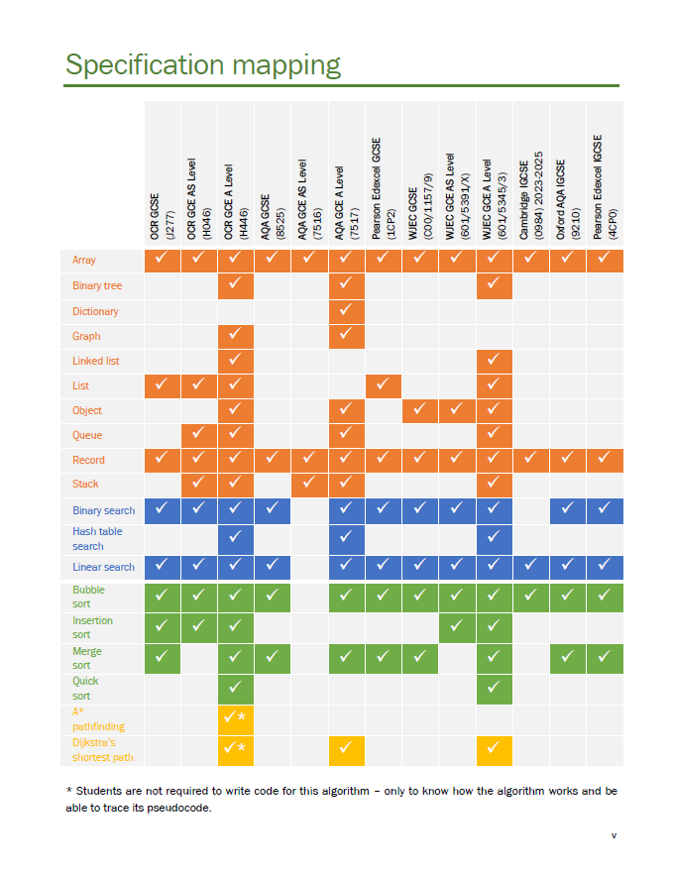

Slide 19
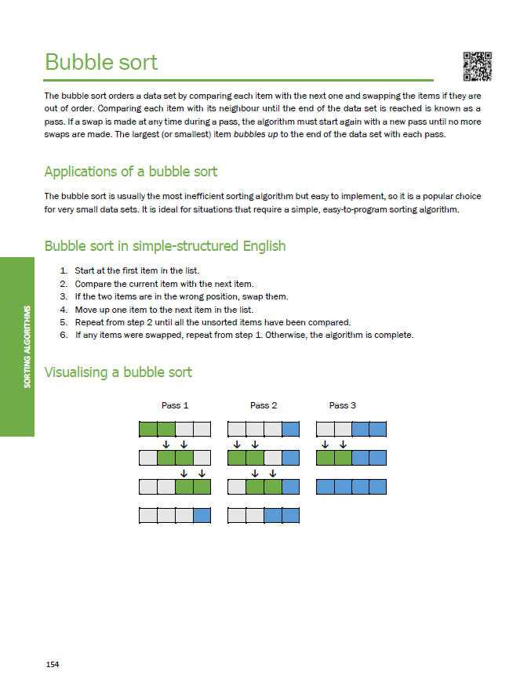
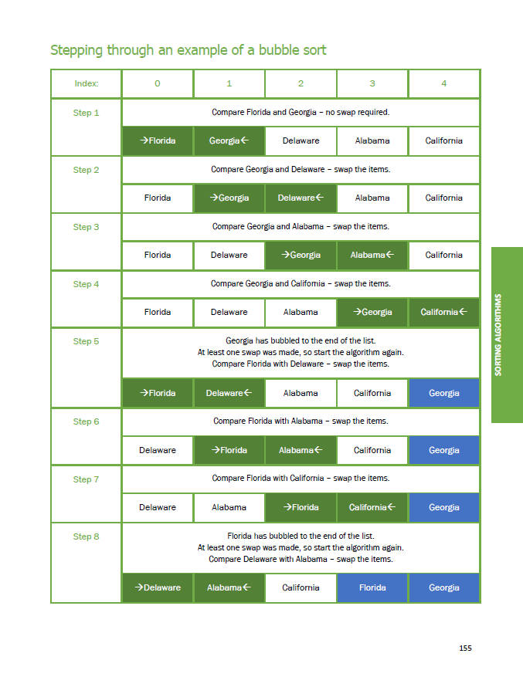

Slide 20
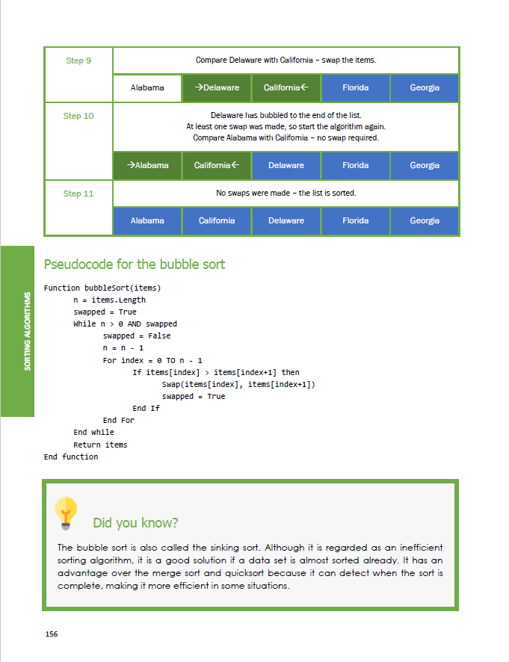
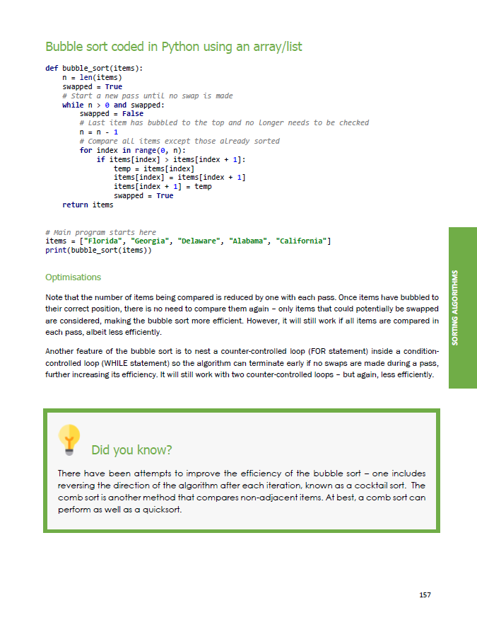

Slide 21


